Slide 1

Motivation-1 : Global warming
Emission of greenhouse gas such as Carbon Dioxide play major role in global warming.

Slide 2
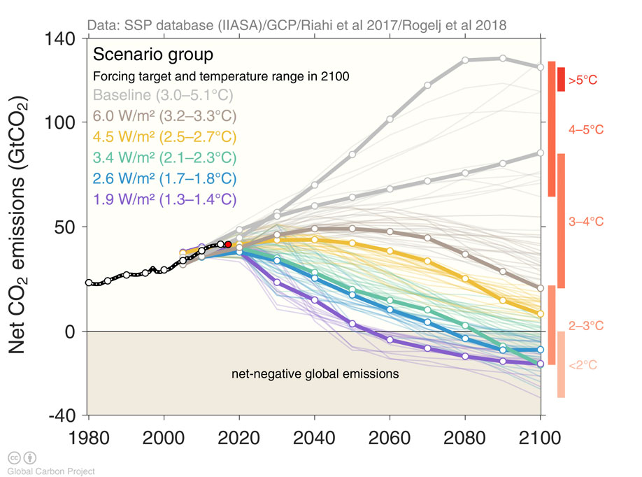
How does carbon dioxide emission affect global warming?
Without carbon regulation policy
Global warming can be alleviated by reducing carbon emission
With carbon regulation policy
Notes:
To reduce carbon emission, we need to accurately measure carbon usage. Let’s see how accurate our measurements are.

Slide 3
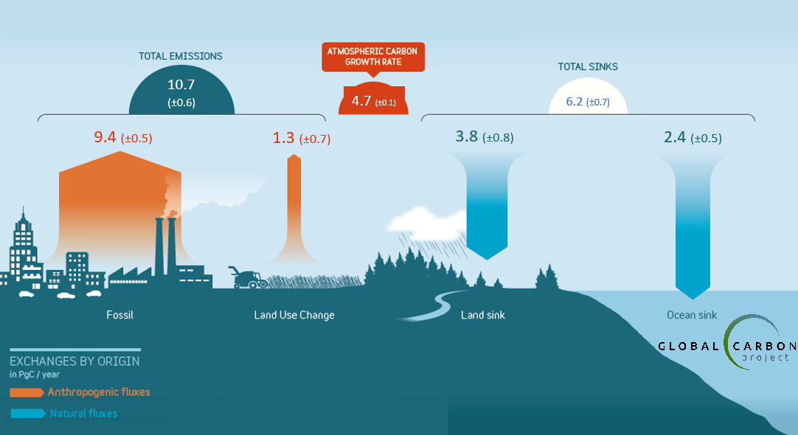
Uncertainty in the land carbon sink
Reducing land carbon sink uncertainty is helpful in accurately defining carbon budget
This is particularly useful in devising carbon regulation policy
Notes:
Uncertainties:
Land sink +/- 0.8 Gt/year (almost equivalent to the total EU emissions in one year)
*Point out that the land sink is the net flux of two large gross fluxes. So narrowing the error bars on the gross uptake of CO2 is one key piece of the puzzle.
Trees are one of the major contributor in Land sinks.

Slide 4

Motivation-2: Plant health
World population is expected to rise to 9 billion by 2050
We need efficient crop to feed the population
So, we need to monitor plant health in order to maintain productivity!
Notes:
Uncertainties:
Land sink +/- 0.8 Gt/year (almost equivalent to the total EU emissions in one year)
*Point out that the land sink is the net flux of two large gross fluxes. So narrowing the error bars on the gross uptake of CO2 is one key piece of the puzzle.
Trees are one of the major contributor in Land sinks.

Slide 5
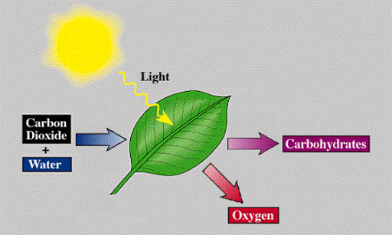
What’s the solution?
Plants use Carbon Dioxide in photosynthesis process.
Furthermore, Efficient photosynthesis process indicate healthy plants.
Hence, tracking photosynthesis is useful for tracking carbon usage and plant health.
Notes:
I introduced you two problems- making carbon measurement accurate and monitoring plant health. Here’s the solution.

Slide 6

Developing a predictive modelling approach for remote measurement of leaf photosynthetic function
By Hrishikesh Patel
Date : 12th May 2021

Slide 7
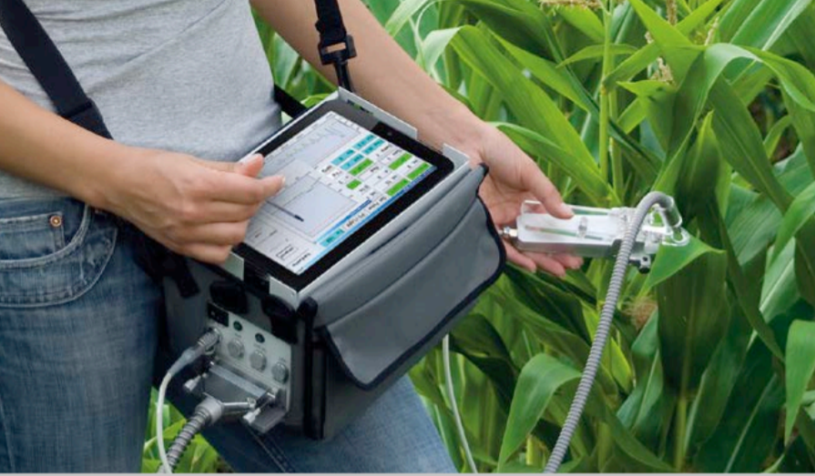
How to track Photosynthesis?
Using Pulse Amplitude Modulation (PAM), we can track photosynthetic activity inside plant.
Is it feasible at larger scale?
Pulse Amplitude Modulation (PAM)
Notes:
-fluorescence is nothing but a light emitted by plant which is not visible to human eye. Healthy plant emits abundant fluorescence, indicating healthy functioning in plant.

Slide 8
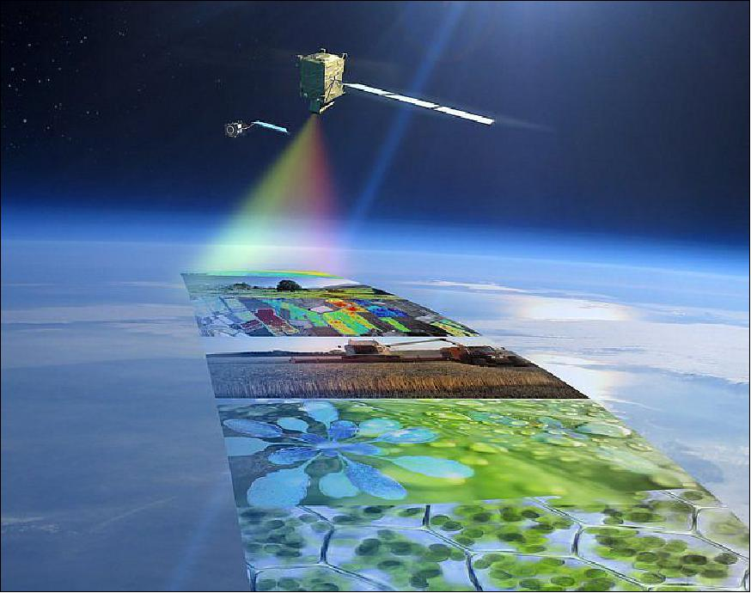
How to track Photosynthesis at a larger scale?
Using satellites, we can take spectral measurements such as Solar Induced Fluorescence (SIF), which can act as a proxy for photosynthetic measurement.
Notes:
-fluorescence is nothing but a light emitted by plant which is not visible to human eye. Healthy plant emits abundant fluorescence, indicating healthy functioning in plant.

Slide 9
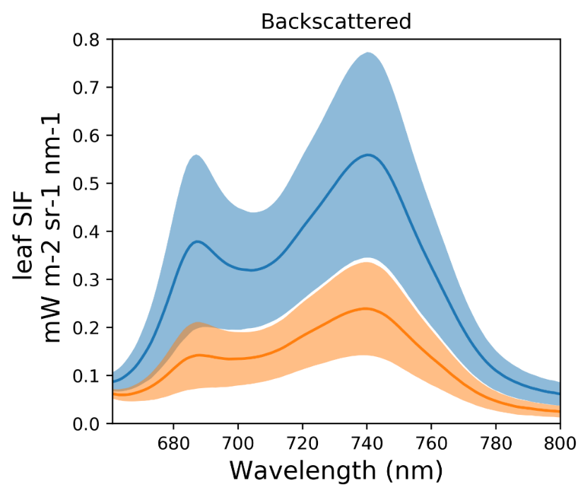
Fluorescence as an indicator for photosynthesis
Fluorescence is a mechanism in plants to get rid of excess light
Low light situation indicates plant is not stressed and photosynthesis is efficient
In presence of excess light, plant gets stressed, so photosynthesis is not efficient.
Dark Adapted
Light Adapted
Notes:
Explain what is SIF.

Slide 10


Objectives
1
2
To develop a predictive model for tracking photosynthesis from sun-induced fluorescence (SIF) data
To identify optimal wavelengths from SIF explaining photosynthesis

Slide 11
Data science process to achieve the objectives
Data Exploration
Understand data
Model Selection
Model Evaluation
Model performance on Test data
Model Training and Validation
Model Analysis
Estimate variable importance
Handle key data issues
Model Validation
Find optimal set of variables
Comparison with benchmark model
Objective-1
Objective-2

Slide 12
Data exploration step
Data Exploration
Understand data
Model Selection
Model Evaluation
Model performance on Test data
Model Training and Validation
Model Analysis
Estimate variable importance
Handle key data issues
Model Validation
Find optimal set of variables
Comparison with benchmark model

Slide 13
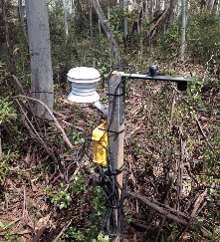

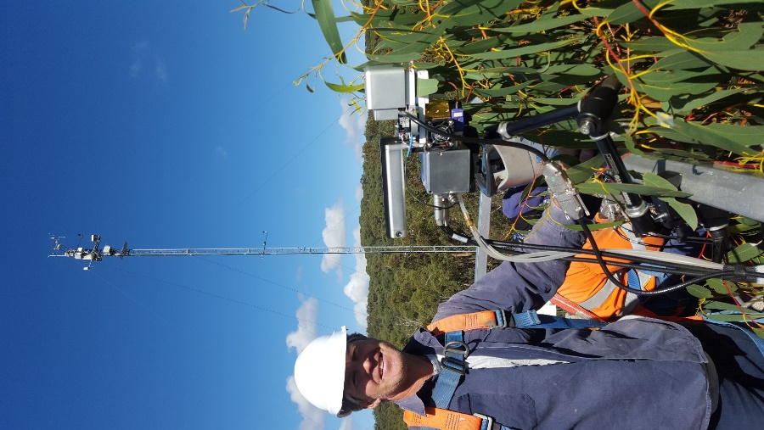


Understand the data
Point & leaf
Satellite & global level
Tower & site level
Notes:
-fluorescence is nothing but a light emitted by plant which is not visible to human eye. Healthy plant emits abundant fluorescence, indicating healthy functionig in plant.

Slide 14
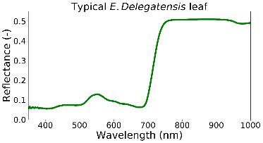
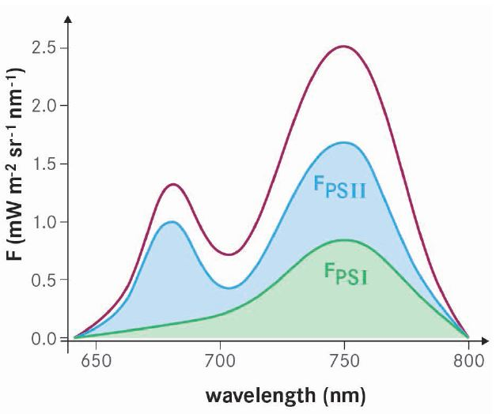
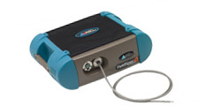


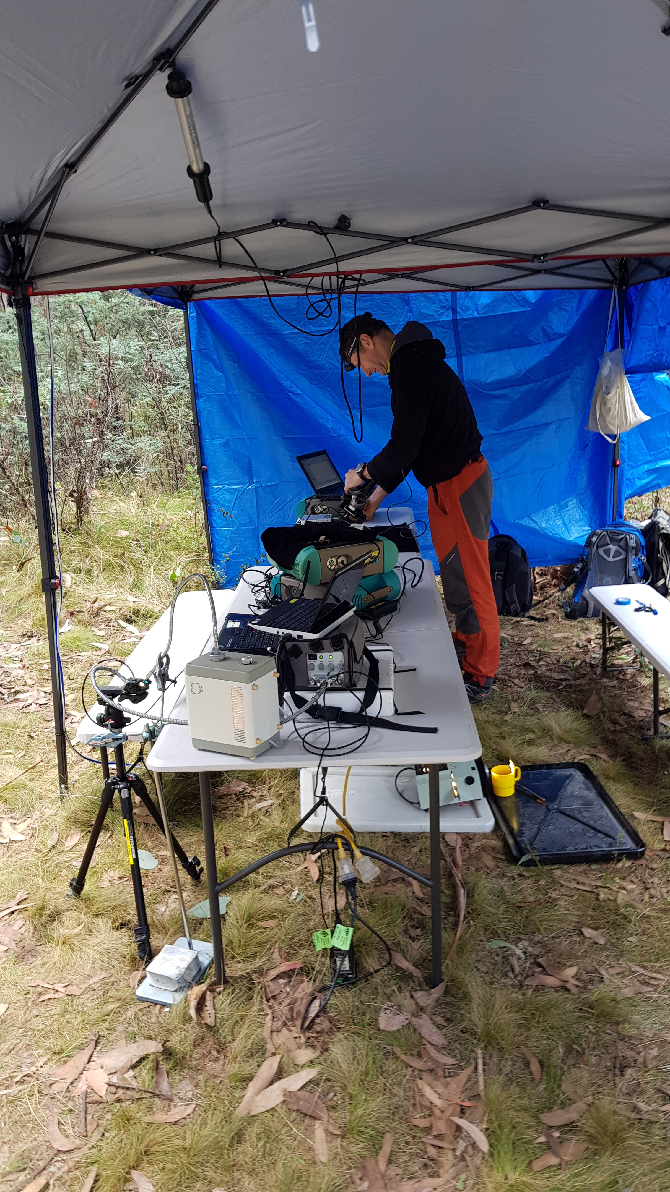
Leaf level data schematic
2D array (DataFrame)
Response variables (PAM metrics)
Spectral columns
Other ‘ancillary’ measured variables (e.g. treatment type, pigments)
Ancillary variables
(treatment, pigment content…)
Response vars (YNPQ, YPSII…)
Spectral bands (SIF)
Observations
# 1,…,193
abChl, N ++
Notes:
-fluorescence is nothing but a light emitted by plant which is not visible to human eye. Healthy plant emits abundant fluorescence, indicating healthy functioning in plant.

Slide 15
Chosen subset of leaf level data
2D array (DataFrame)
Target -> YPSII
Predictors -> Spectral columns
Target (YPSII…)
Predictors - Spectral bands (SIF)
Observations
# 1,…,193
< DataFrame (193 rows by 191 cols) >
Notes:
-fluorescence is nothing but a light emitted by plant which is not visible to human eye. Healthy plant emits abundant fluorescence, indicating healthy functionig in plant.

Slide 16
Leaf level data preview
661 | 662 | 663 | … | 848 | 849 | 850 | YPSII
4.4384E-06 | 4.5592E-06 | 4.7343E-06 | … | 1.4207E-06 | 1.3397E-06 | 1.22094E-06 | 0.699
3.4836E-06 | 3.6761E-06 | 3.9017E-06 | … | 1.3031E-06 | 1.2243E-06 | 1.20479E-06 | 0.737
2.9612E-06 | 2.9379E-06 | 2.9428E-06 | … | 5.5157E-07 | 5.6485E-07 | 5.7174E-07 | 0.629
2.457E-06 | 2.4601E-06 | 2.4538E-06 | … | 5.1225E-07 | 5.0102E-07 | 4.18509E-07 | 0.656
2.6161E-06 | 2.6501E-06 | 2.7074E-06 | … | 6.8262E-07 | 7.0915E-07 | 6.1453E-07 | 0.726
Notes:
-fluorescence is nothing but a light emitted by plant which is not visible to human eye. Healthy plant emits abundant fluorescence, indicating healthy functionig in plant.

Slide 17
Data exploration step
Data Exploration
Understand data
Model Selection
Model Evaluation
Model performance on Test data
Model Training and Validation
Model Analysis
Estimate variable importance
Handle key data issues
Model Validation
Find optimal set of variables
Comparison with benchmark model

Slide 18
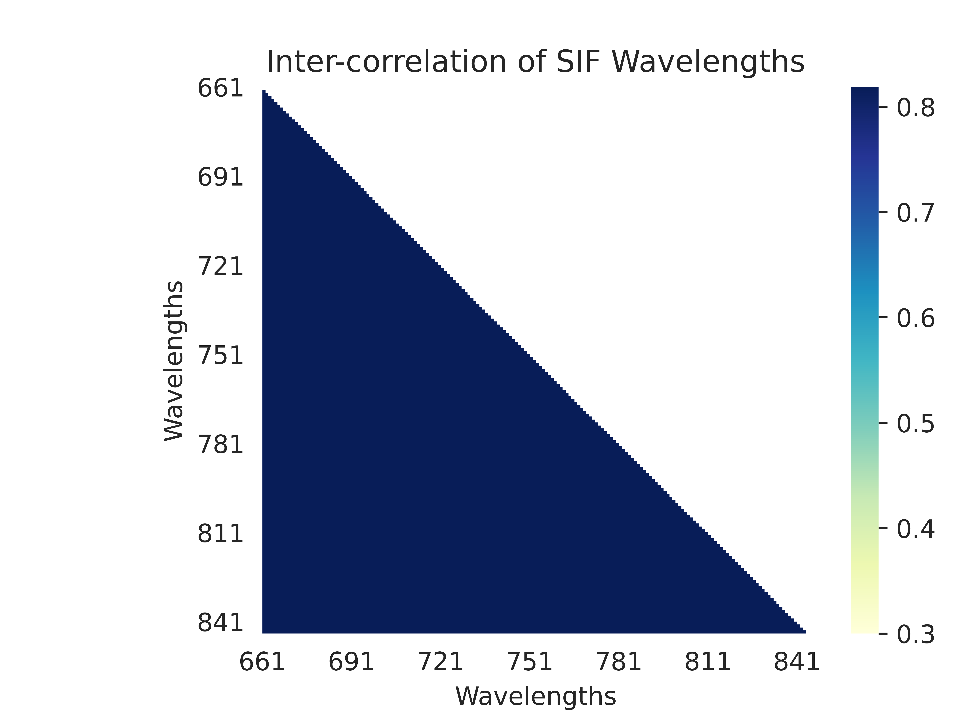
Multicollinearity
Solution: Use tree-based models such as Random Forest as they are robust to multicollinearity in the aspect of prediction accuracy

Slide 19
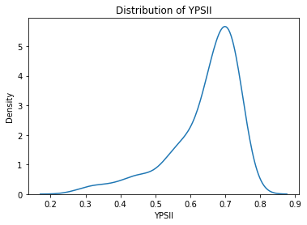
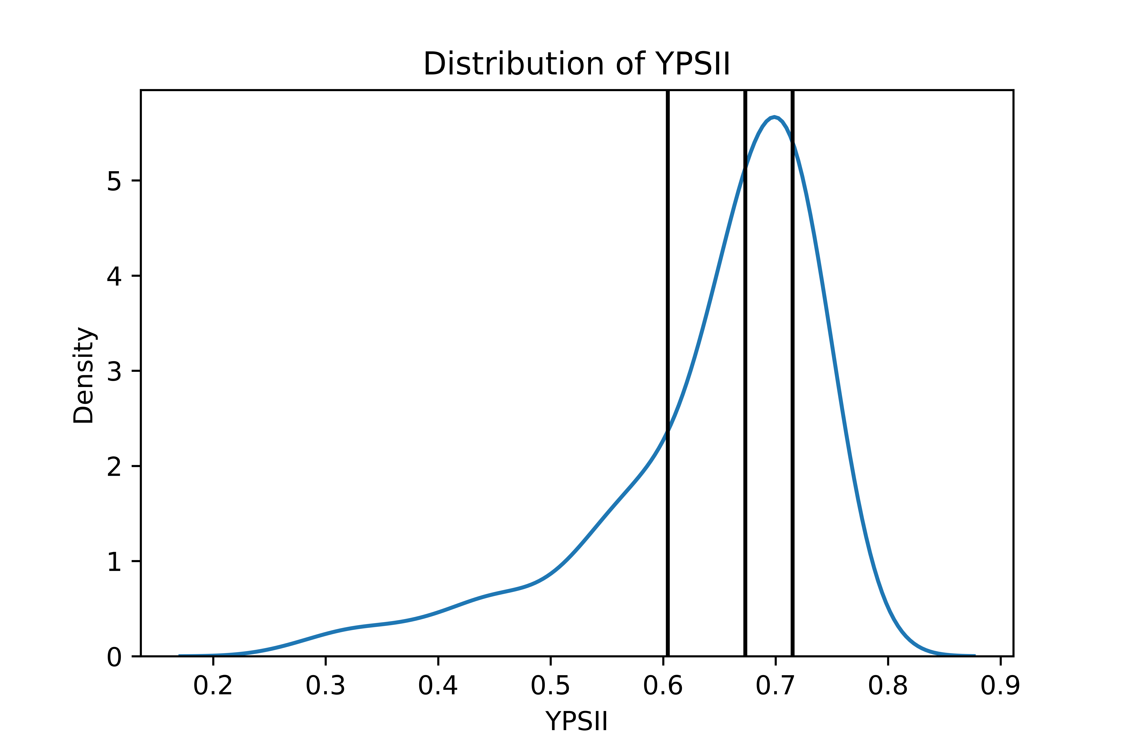
Bias due to skewed target
1
2
3
4

Slide 20
Model training and validation step
Data Exploration
Understand data
Model Parameter Optimization
Model Evaluation
Model performance on Test data
Model Training and Validation
Model Analysis
Estimate variable importance
Handle key data issues
Find optimal set of variables
Comparison with benchmark model

Slide 21

Model : Random forest regressor
Why Random Forest? - Robust to overfitting - Effect of multicollinearity is alleviated - Can estimate feature importance

Slide 22

Choosing optimal model parameters
Number of Data Points
- Training data = 154
- Each folds = 31
- Test data = 39

Slide 23
Model evaluation step
Data Exploration
Understand data
Model Parameter Optimization
Model Evaluation
Model performance on Test data
Model Training and Validation
Model Analysis
Estimate variable importance
Handle key data issues
Find optimal set of variables
Comparison with benchmark model

Slide 24
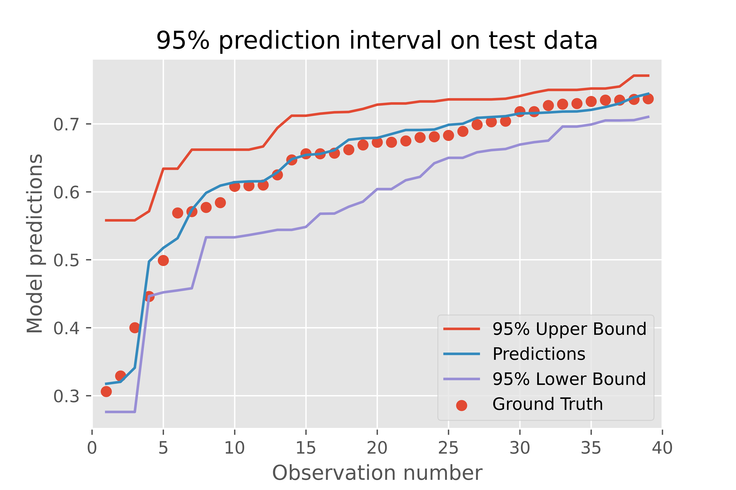
Model performance on test-set
Metric | Random Forest
R-Squared | 86.05 %
Mean Squared Error | 0.0016
Mean Absolute Error | 0.0293

Slide 25
Model evaluation step
Data Exploration
Understand data
Model Parameter Optimization
Model Evaluation
Model performance on Test data
Model Training and Validation
Model Analysis
Estimate variable importance
Handle key data issues
Find optimal set of variables
Comparison with benchmark model

Slide 26
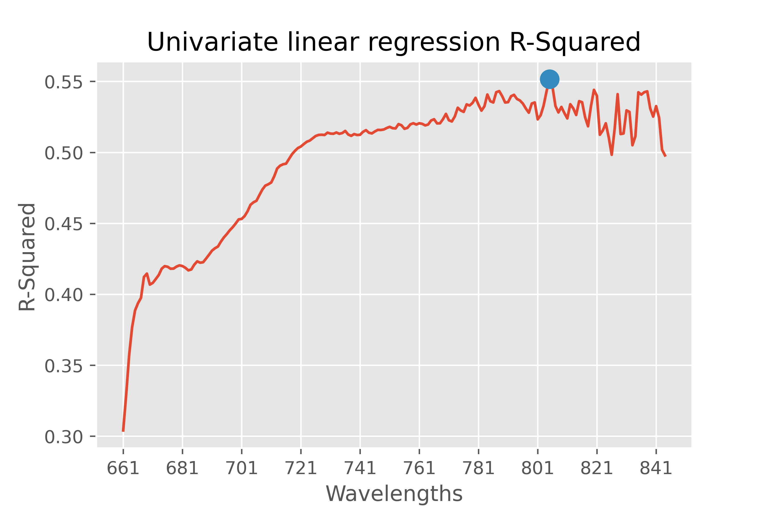
Comparing model performance with benchmark
Metric | Random Forest | Linear Regression
R-Squared | 86.05 % | 55.17%
Mean Squared Error | 0.0016 | 0.0080
Mean Absolute Error | 0.0293 | 0.0631

Slide 27
Model analysis step
Data Exploration
Understand data
Model Parameter Optimization
Model Evaluation
Model performance on Test data
Model Training and Validation
Model Analysis
Estimate variable importance
Handle key data issues
Find optimal set of variables
Comparison with benchmark model

Slide 28
Estimating variable importance
Before bootstrapping
After bootstrapping
Do we need all of the
variables to estimate target?

Slide 29
Model analysis step
Data Exploration
Understand data
Model Parameter Optimization
Model Evaluation
Model performance on Test data
Model Training and Validation
Model Analysis
Estimate variable importance
Handle key data issues
Find optimal set of variables
Comparison with benchmark model

Slide 30
Finding optimal set of variables
Elbow point
Knee point

Slide 31
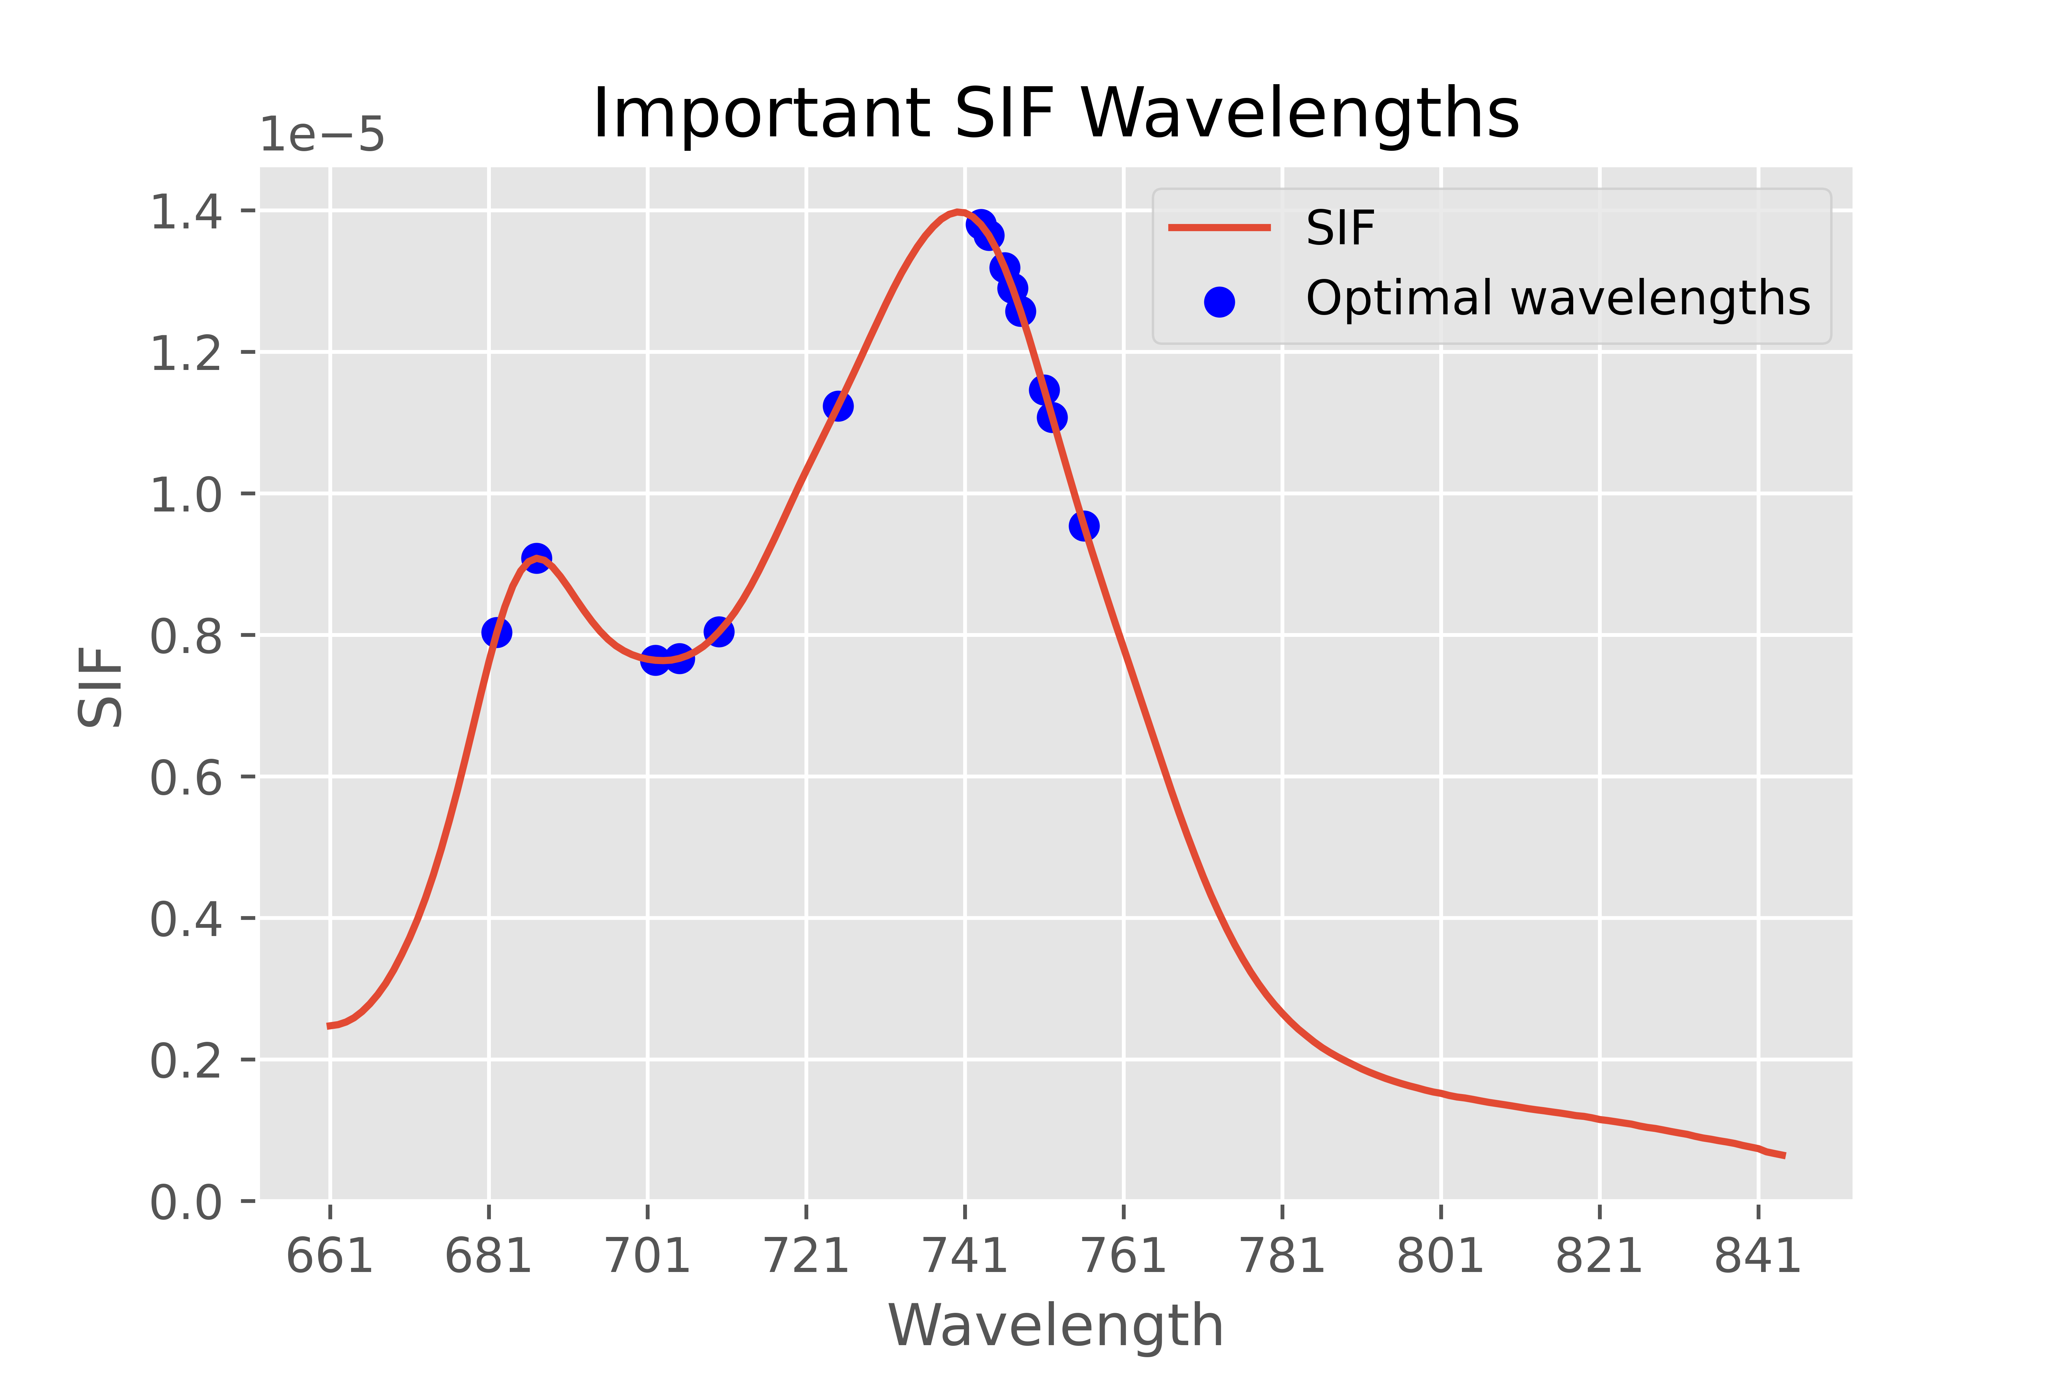
Finding optimal set of variables
The selected wavelengths can explain 85% of variance in target variable.

Slide 32
How optimal are these wavelengths?
Metric | Random Forest - 25 | Random Forest - Full
R-Squared | 85.20% | 86.27%
Mean Squared Error | 0.0017 | 0.0015
Mean Absolute Error | 0.0301 | 0.0290

Slide 33
Conclusion
With 86% r-squared value, random forest regressor model can help predicting photosynthesis from SIF with greater confidence.
Furthermore, we also found that not all SIF wavelengths are important to predict photosynthesis. With only 25 wavelengths out of 190, we could obtain comparable result.

Slide 34
Recommendations
New models can be tried on SIF data for higher accuracy
Potential to scale to satellite level
Product development for measuring plant health remotely

Slide 35

Project reflection : Challenges
Data were not quite rich
Computationally expensive model training
Model selection

Slide 36




Project reflection : Used tools
Python language
Google Colaboratory
UQ Research Data Manager
Slack

Slide 37

Thank you for your attention! Any Questions? Feel free to email me at hrishikesh.pe@gmail.com

